Slide 1
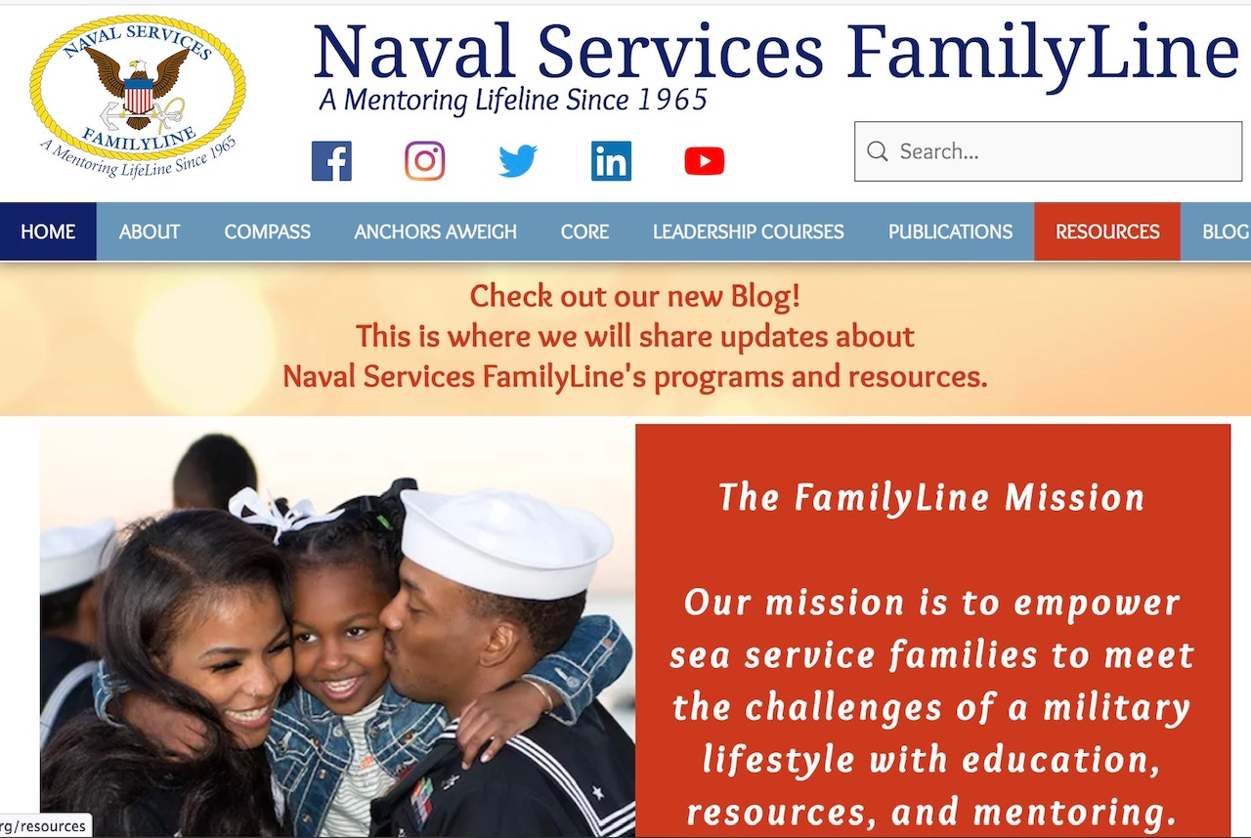

Slide 2
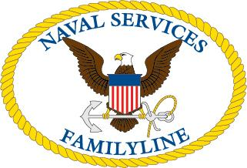
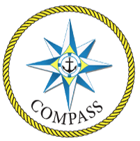
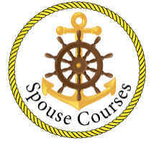
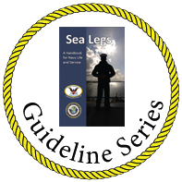
Information. Resources. Mentoring.
Creating a network of informed Navy families by focusing on these four components:
COMPASS/ Setting Sail is a team mentoring program developed by spouses, for spouses. This course helps spouses understand and meet the challenges of the navy lifestyle.
The Command Spouse Leadership Course (CSLC) and the Command Master Chief / Chief of the Boat Spouse Leadership Course (CMCSLC) are intense one-week, executive level courses for spouses of Commanding Officers, Command Master Chiefs, Chiefs of the Boat and Command Senior Chiefs en route to their first command tour.
Naval Services FamilyLine Publications, volunteers have been creating and publishing guidelines for United States Navy families since 1965. These publications are available in print or online. Each publication is free-of-charge for our Navy families.
C O R E (Continuum of Resources and Education) offers a selection of seminars, workshops, classes, and individuals dedicated to empowering the Navy spouse, educating the Navy family and promoting the Navy lifestyle.

Slide 3
Resources Online
Naval Services FamilyLine Website
www.nsfamilyline.org
Social Media – Facebook, Twitter, LinkedIn
Collaborated with CNIC
MyNavyFamilyApp
CPO Selectee Spouse Webinar
Expanding our virtual presence
Educational seminars, bookclubs, mentor meet ups & gatherings

